Slide 1
VIIRS Aerosol Products: Algorithm Development and Air Quality Applications
NOAA/NESDIS/STAR Aerosol Cal/val Team
Presented by Lorraine Remer, UMBC

Slide 2
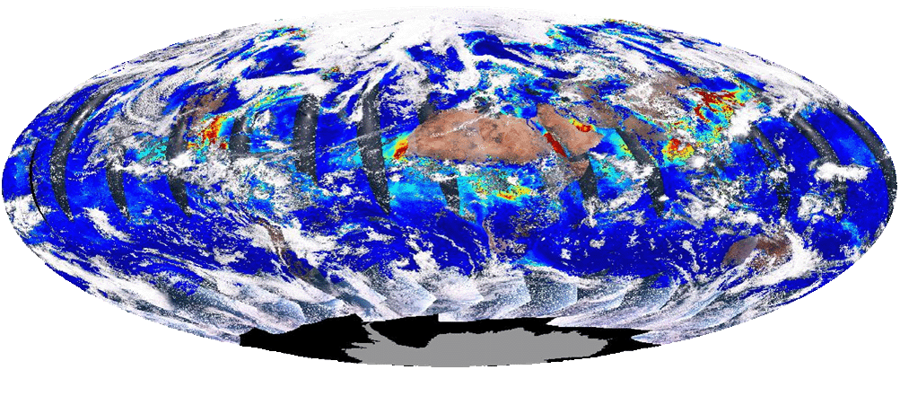
Outline
VIIRS instrument
VIIRS aerosol algorithm
VIIRS aerosol products
AOT Validation
Applications

Slide 3
VIIRS instrument
Bands used for aerosol
cross-track scanning
~3000 km swath
7 years lifetime
0.742 x 0.776 km nadir resolution
2% absolute radiometric accuracy
single look
no polarization

Slide 4
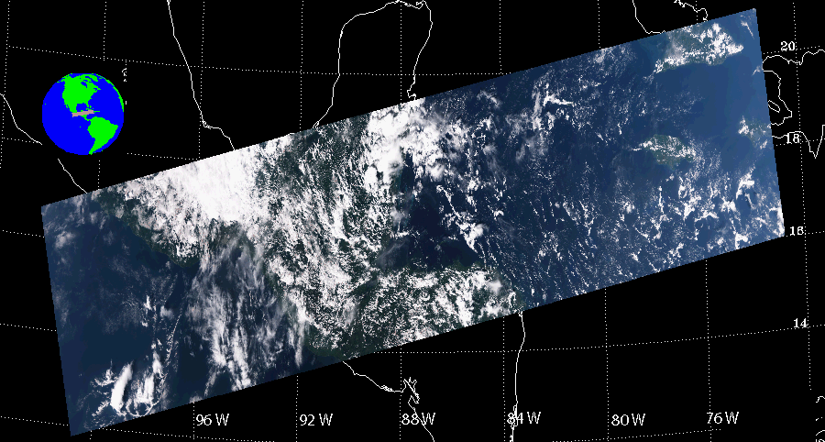
VIIRS
Processing is on a granule by granule basis
  86 seconds; 48 scan lines; 3040 km swath width; 768 x 3200 (along-track by cross-track) 0.75-km pixels
Example VIIRS granule, 11/02/2013, 19:05 UTC
RGB image

Slide 5
VIIRS Aerosol Algorithm
Multi-spectral over dark surface
Separate algorithms used over land and ocean
Algorithm heritages
  over land: MODIS atmospheric correction (MOD09)
  over ocean: MODIS aerosol retrieval (MOD04)
Many years of development work:
  Initial science version by Raytheon
  Updates and modifications by NGAS
  NOAA Cal/Val Team’s responsibility is to maintain, evaluate and improve the algorithm

Slide 6
Over land retrieval
Channels used: 0.41, 0.44, 0.48, 0.67, and 2.25 µm
  Prescribed surface reflectance ratio (0.48 and 0.67 µm)
Simultaneous retrieval of AOT and surface reflectance for a given aerosol model
Select aerosol model [Dubovik et al., 2002]

Slide 7
Over ocean retrieval
Channels used: 0.67, 0.74, 0.86, 1.24, 1.61, and 2.25 µm
Wind-dependent (speed and direction) ocean surface reflectance is calculated analytically.
Combines 5 fine mode and 4 coarse mode models (2020 models)
Finds AOT and aerosol model that best matches the VIIRS-measured TOA spectral reflectance.

Slide 8
VIIRS Aerosol Products
  Aerosol Optical Thickness (AOT) (11 wavelengths, land and ocean)
  APSP (Aerosol Particle Size Parameter)
  Ångström Exponent (445 nm/672 nm) over land, (865 nm/1610 nm) over ocean
  over-land APSP product is not recommended!
Suspended Matter (SM)
  classification of aerosol type (dust, smoke, sea salt, volcanic ash) and smoke concentration
Day time, dark land, non-sunglint ocean

Slide 9
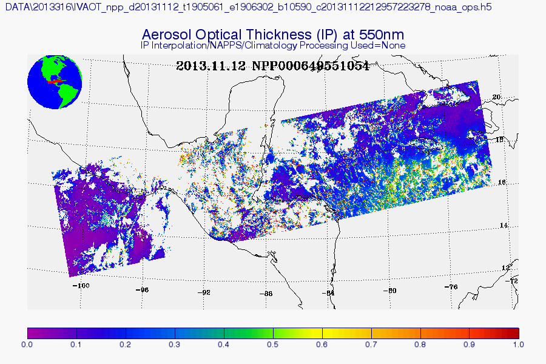
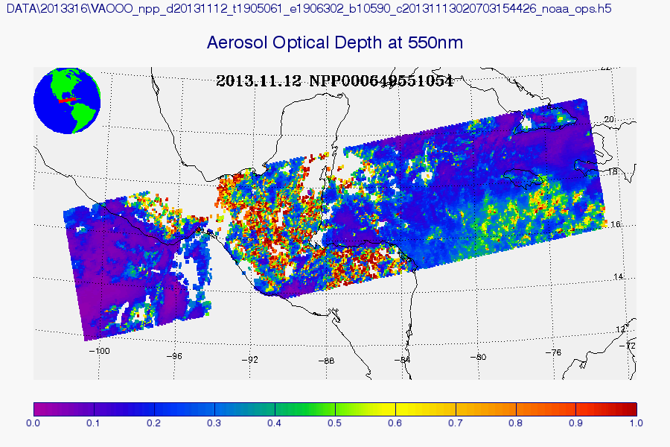
At NOAA Comprehensive Large Array-data Stewardship System (CLASS):
Intermediate Product (IP)
  0.75-km pixel
Environmental Data Record (EDR)
  6 km aggregated from 8x8 IPs filtered by quality flags
  0.75 km (SM only)

Slide 10
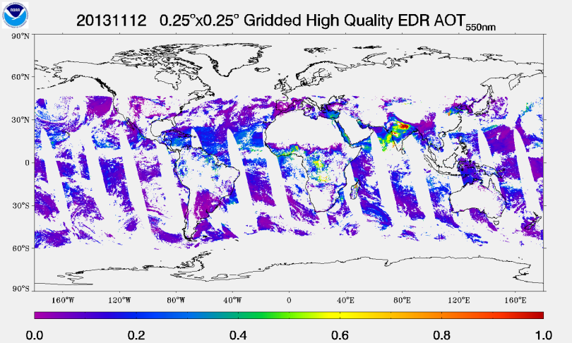
At NOAA/NESDIS/STAR
  Gridded 550-nm AOT EDR (0.25x0.25 degree)

Slide 11
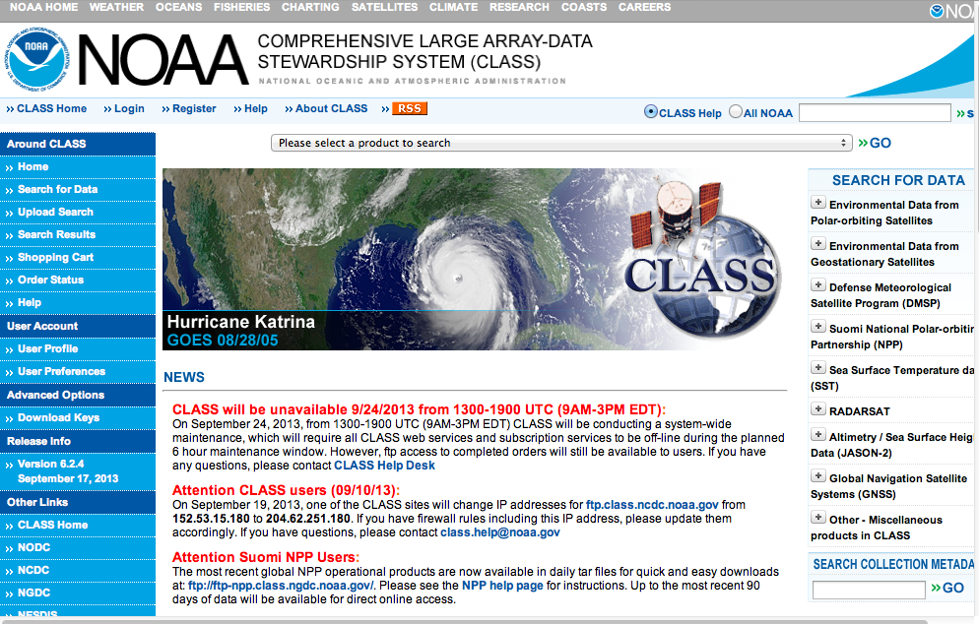
NOAA CLASS: The Primary Gateway for the VIIRS Data Distribution
http://www.class.ncdc.noaa.gov/saa/products/welcome
11

Slide 12

NOAA Cal/Val web: VIIRS aerosol information and gridded AOT
http://www.star.nesdis.noaa.gov/smcd/emb/viirs_aerosol/index.php
Products page has a link to FTP site for data download
Document links to ATBD, user’s guide, etc.
Software to display VIIRS aerosol products and convert data to MODIS-like EOS HDF format are available for download
Latency for daily global gridded product availability is 1-2 days
12

Slide 13
AOT Product Timeline
Products go trough various levels of maturity:
Initial instrument check out; Tuning cloud mask parameters | Beta status | Error | Beta status | Validation Stage 1 status
28 Oct 2011
2 May 2012
15 Oct 2012
28 Nov 2012
23 Jan 2013
Red period: | Product is not available to public, or product should not be used.
Blue period: (Beta) | Product is available to public, but it should be used with caution, known problems, frequent changes.
Green period: (Validated) | Product is available to public; users are encouraged to evaluate and use in applications

Slide 14
Validation
Comparisons with AERONET
High quality VIIRS
Accuracy: 0.013
Precision: 0.061
R=0.906
%EE 64%
N=7713
High quality MODIS
Accuracy: 0.001
Precision: 0.059
R=0.909
%EE 64%
N=1931
High quality VIIRS
Accuracy: -0.009
Precision: 0.13
R=0.773
%EE 71%
N=9525
High quality MODIS
Accuracy: -0.005
Precision: 0.106
R=0.886
%EE 65%
N=4990

Slide 15
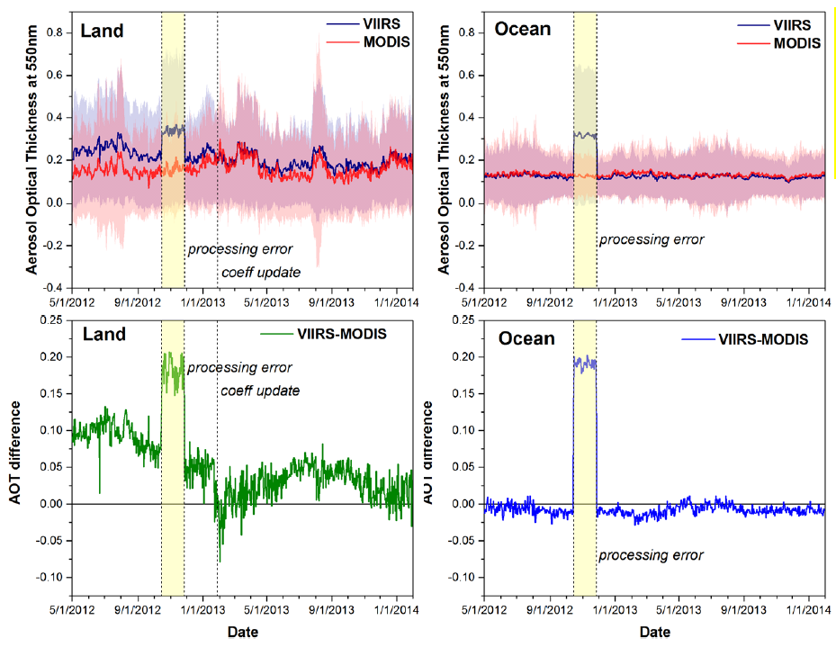
Validation
Comparisons with MODIS C5

Slide 16
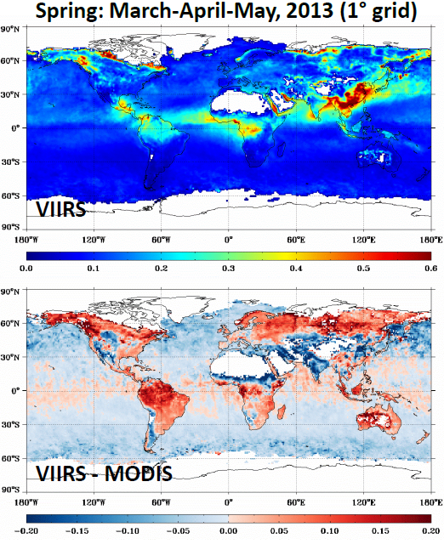
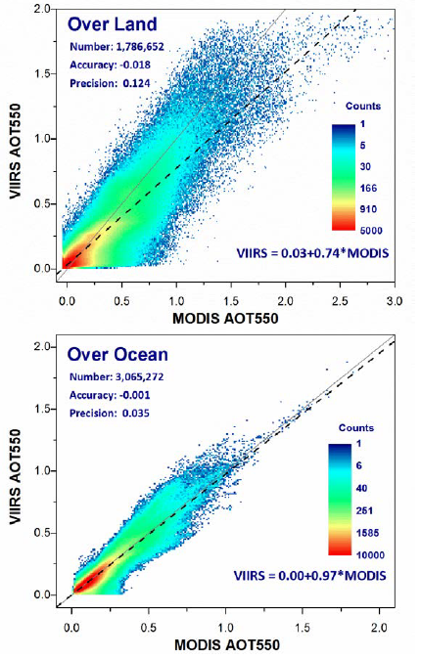
Land
N=1,786,652
Acc: -0.018
Prec: 0.124
Ocean
N=1,065,272
Acc: -0.001
Prec: 0.035

Slide 17
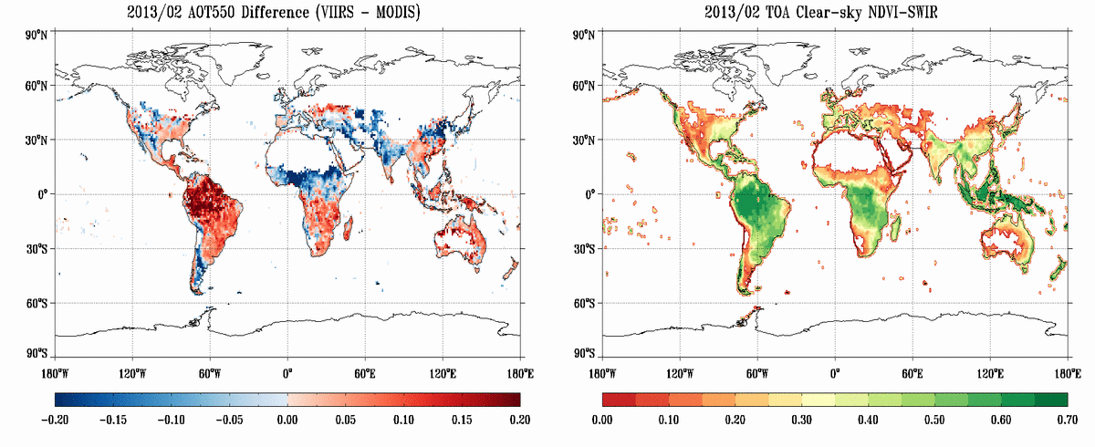
  Higher VIIRS AOT (red) over vegetated areas (green)
  Lower VIIRS AOT (blue) over soil (red)

Slide 18
Air Quality Applications
VIIRS products (AOT, dust/smoke detection) generated from DB data for CONUS and Alaska are provided to operational air quality forecasters and other users with a latency of less than two hours (http://www.star.nesdis.noaa.gov/smcd/spb/aq/)
  Plans to reduce the latency to “under 20 min” underway
Various users (e.g., EPA) have begun looking at VIIRS aerosol products for transitioning their decision support systems from MODIS to VIIRS
NWS to begin evaluating NGAC (NOAA Global Forecasting System – Aerosol Component) dust forecasts using VIIRS “dust AOT”

Slide 19
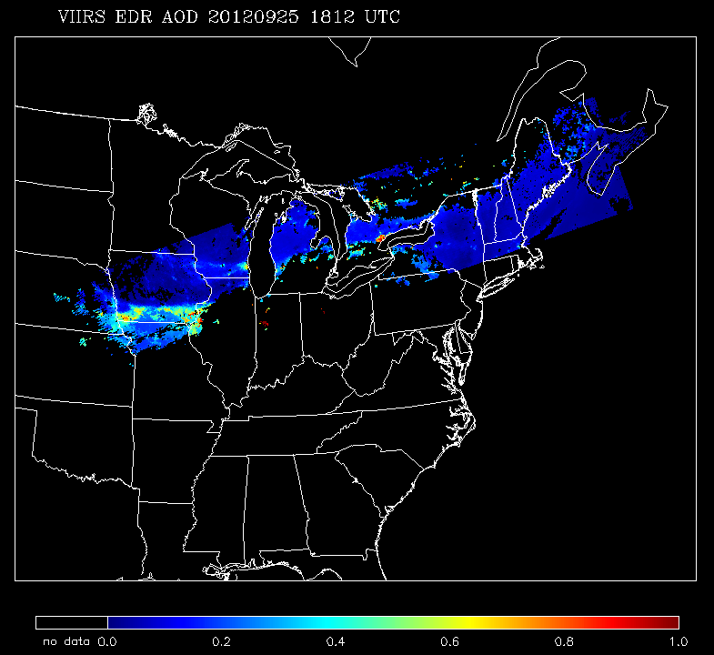
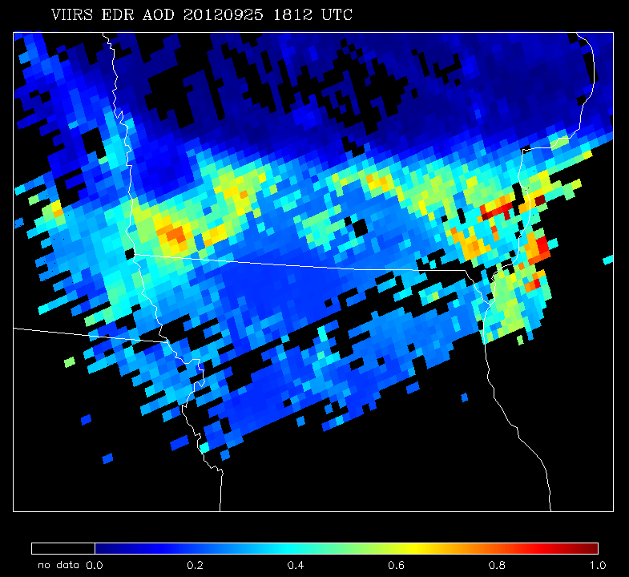
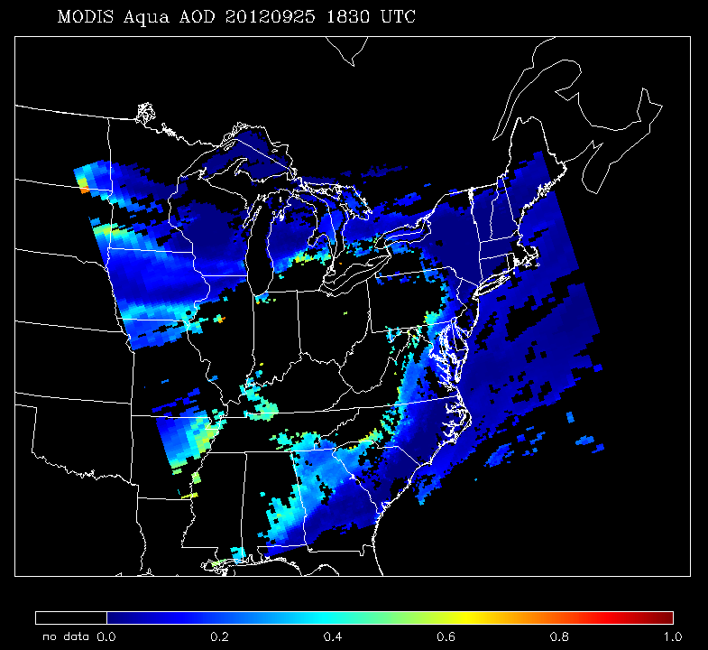
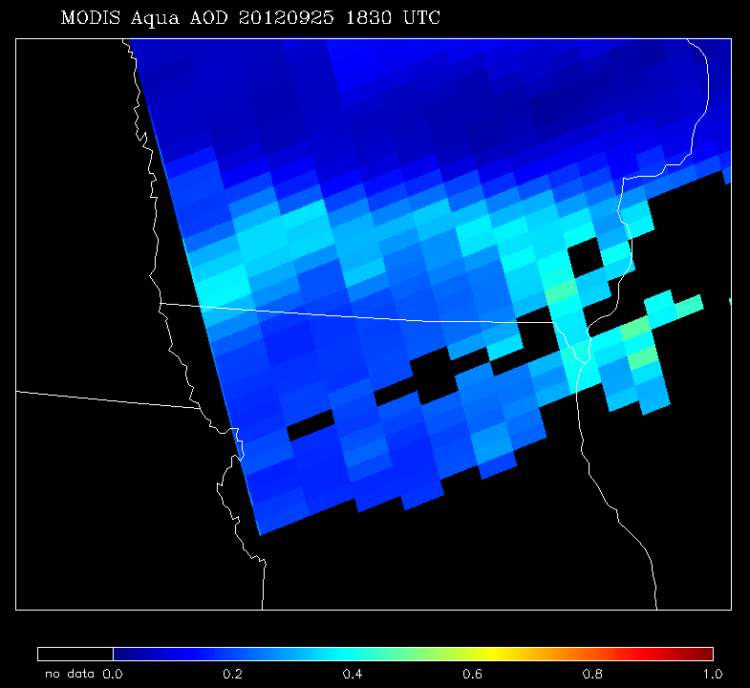
VIIRS Edge of Scan (EOS)
 | MODIS | VIIRS
Orbit altitude | 690 km | 824 km
Equator crossing time | 13:30 LT | 13:30 LT
Granule size | 5 min | 86 sec
swath | 2330 km | 3040 km
Pixel nadir | 0.5 km | 0.75 km
Pixel edge | 2 km | 1.5 km
EDR AOT Product nadir | 10 km | 6 km
EDR AOT Product EOS | 40 km | 12 km
* Information applicable to current MODIS standard C5 products

Slide 20
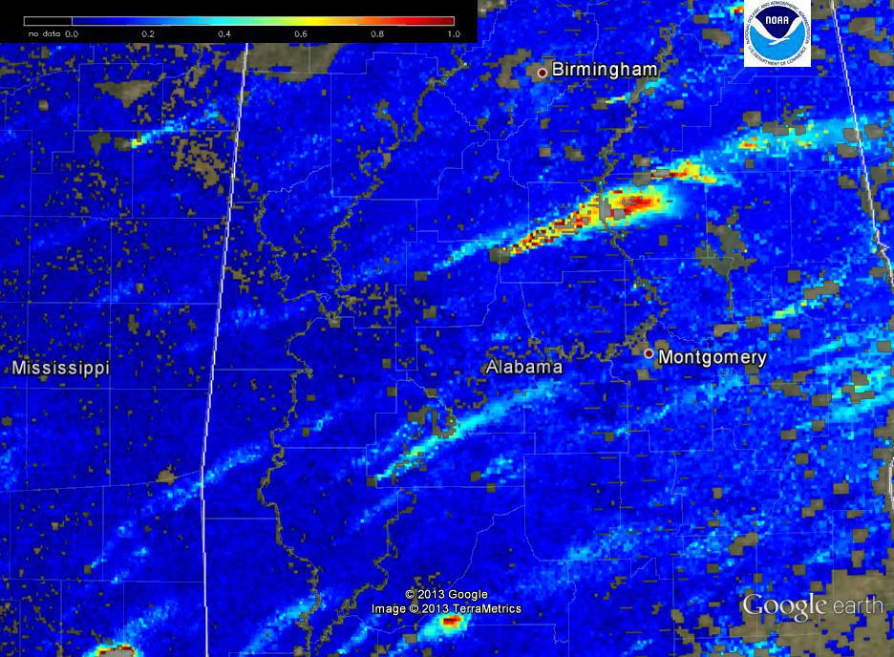
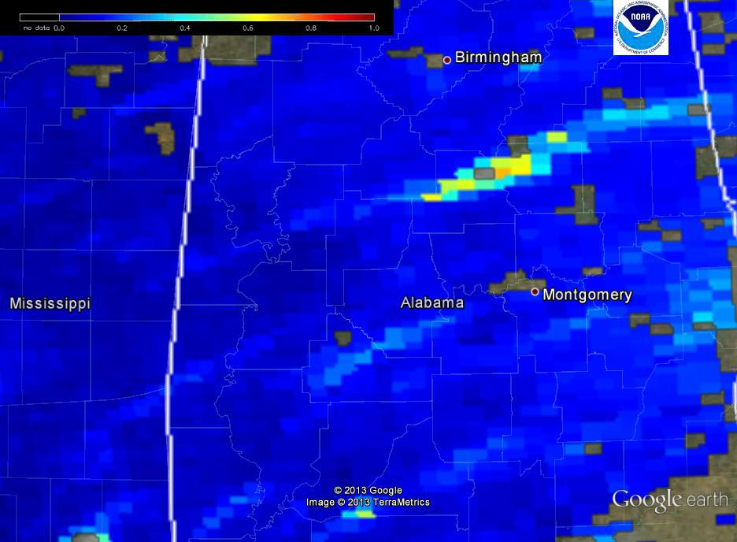
VIIRS High Resolution AOT
Spatial resolution of IP (750 m) vs. EDR (6 km) pixels
Need > 16 IP High AOD pixels for EDR High AOT pixel
Lat/Lon used for center of IP AOT pixels and EDR AOT pixels is different
IP High quality (750 m)
EDR High quality (6 km)

Slide 21
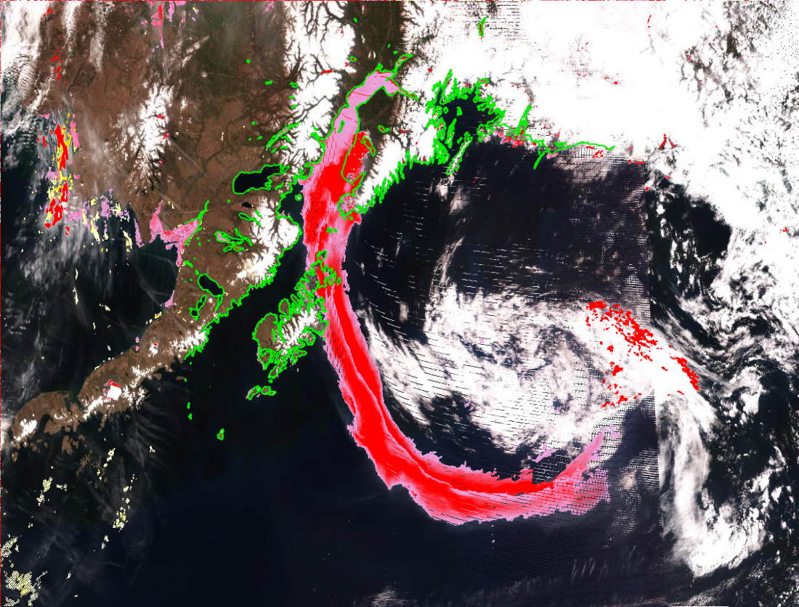
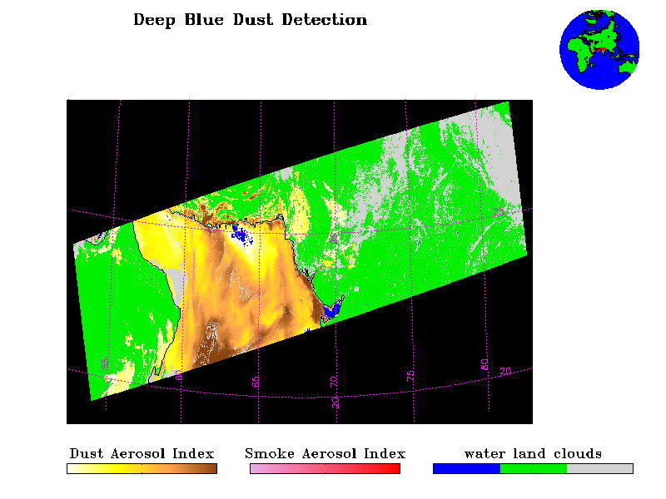
Qualitative Dust and Smoke
Detection Algorithm
Smoke from Funny River fire in Alaska on May 20, 2014
STAR has developed an alternate SM (dust and smoke detection) algorithm:
  based on Aerosol Index that separates dust from non-dust (smoke/haze) aerosols. Takes advantage of deep blue (412 and 445 nm) bands.
Thick Smoke
Thin Smoke
Dust in Arabian Sea on January 13, 2013
DAI = -100*[log₁₀(R_{412nm}/R_{445nm})-log₁₀(R’_{412nm}/R’_{445nm})]
NDAI = -10*[log₁₀(R_{412nm}/R_{2.25um})]

Slide 22
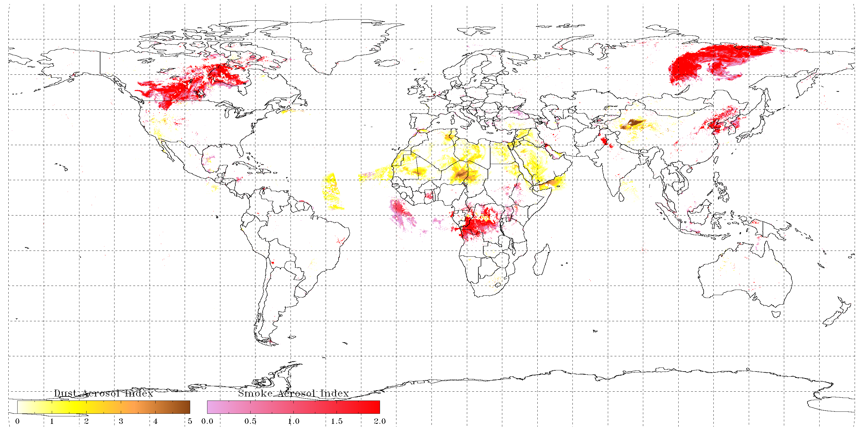
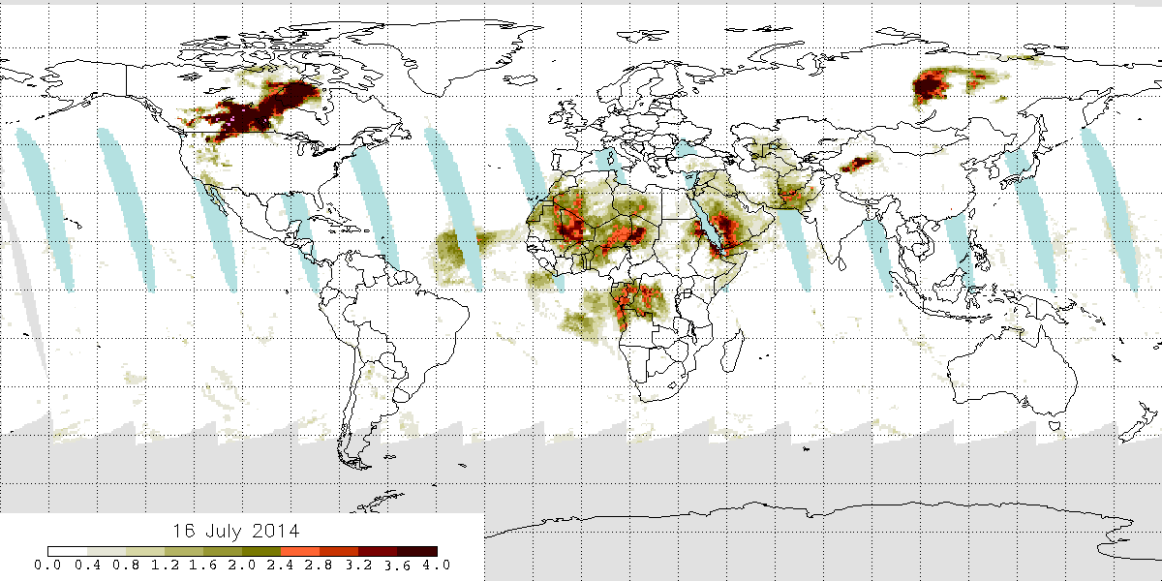
Comparison of VIIRS Dust and Smoke with OMPS Aerosol Index Product
June 16, 2014
VIIRS
OMPS
Not observed by OMPS
False detections from turbid water
VIIRS: Separates dust and smoke. Product accuracy ~70% and not sensitive to low aerosol loading (AOT < 0.2)
OMPS: Absorbing aerosol (includes dust and smoke but does not differentiate the two). Not sensitive to boundary layer aerosol

Slide 23
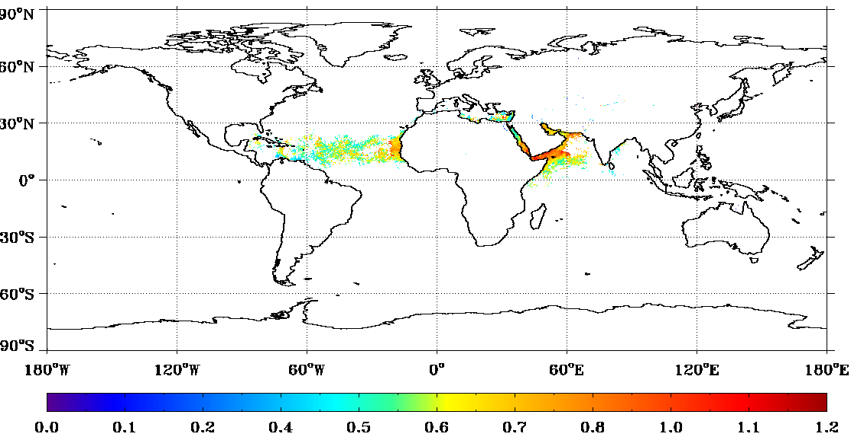
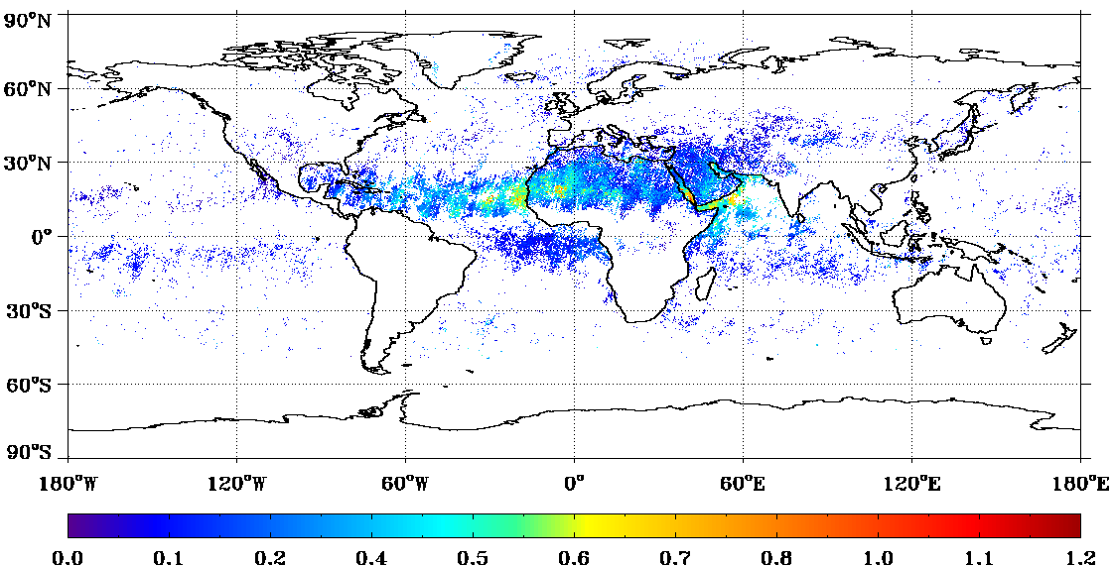

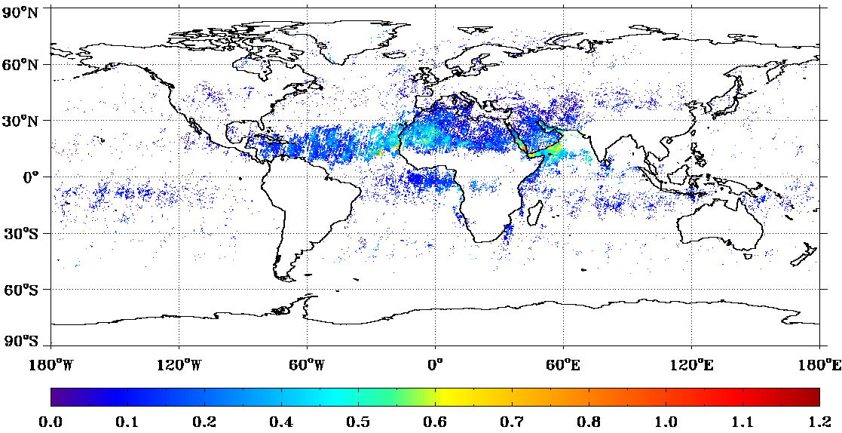

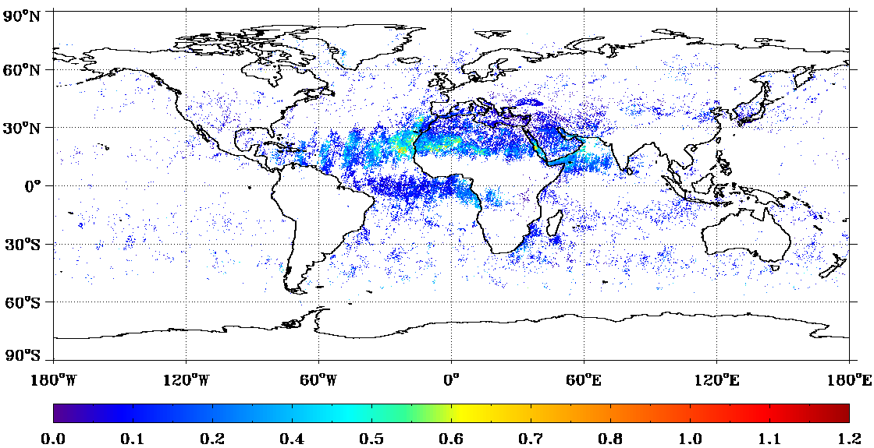
VIIRS “Dust AOT”
MISR “Dust AOT”
VIIRS dust flag + best quality AOT =“dust AOT”.
MISR non-spherical AOT =“dust AOT”.
MISR dust AOT observed over the biomass burning region is likely coarse mode smoke aerosol?
VIIRS dust AOT biased high compared to MISR.
June
June
July
July
August
August

Slide 24
Summary
VIIRS AOT quality is comparable to that of MODIS
VIIRS AOT product is ready for operational use
Publications
  J. Jackson, H. Liu, I. Laszlo, S. Kondragunta, L. A. Remer, J. Huang, and H-C. Huang, Suomi-NPP VIIRS aerosol algorithms and data products, J. of Geophys. Res., DOI: 10.1002/2013JD020449, 2014
  H. Liu, L. A. Remer, J. Huang, H-C. Huang, S. Kondragunta, I. Laszlo, M. Oo, J. M Jackson, Preliminary evaluation of SNPP VIIRS Aerosol Optical Thickness, J. of Geophys. Res., DOI: 10.1002/2013JD020360, 2014
  Ciren, P. and S. Kondragunta, Dust Aerosol Index (DAI) algorithm for MODIS, J. of Geophys. Res., DOI: 10.1002/2013JD020855, 2014

Slide 25
Planned Enhancements
Replace current fixed global surface reflectance relationships with surface-dependent relationships.
Extend AOT reporting range from 2 to 5 and include small negative AOTs.
Consider a hybrid approach (VIIRS-like and MODIS-like) over land.
Update aerosol models with those from MODIS algorithm.
Improve cloud/heavy-aerosol discrimination, snow/ice detection; add spatial variability internal test.
Extend retrievals over bright surfaces.

Slide 26
BACK UP SLIDES

Slide 27
VIIRS
Band name | Wavelength (nm) | Bandwidth (nm) | Use in algorithm
M1* | 412 | 20 | L
M2* | 445 | 14 | L
M3* | 488 | 19 | L, TL TO
M4* | 555 | 21 | TO
M5* | 672 | 20 | L, O, TO
M6 | 746 | 15 | O
M7* | 865 | 39 | O, TL
M8 | 1,240 | 27 | O, TL, TO
M9 | 1,378 | 15 | TL
M10 | 1,610 | 59 | O, TL, TO
M11 | 2,250 | 47 | L, O, TL, TO
M12 | 3,700 | 191 | TL
M13 | 4,050 | 163 | none
M14 | 8,550 | 323 | none
M15 | 10,763 | 989 | TL, TO
M16 | 12,016 | 864 | TT, TO
Visible Infrared Imaging Radiometer Suite (VIIRS)
cross-track scanning radiometer with ~3000 km swath – full daily sampling
7 years lifetime
22 channels (412-12,016 nm)
  16 of these are M bands with 0.742 x 0.776 km nadir resolution
  aerosol retrieval is from M bands
high signal-to-noise ratio (SNR):
  M1-M7: ~200-400
  M8-M11: ~10-300
2% absolute radiometric accuracy
single look
no polarization
*dual gain, L: land, O: ocean; T: internal test

Slide 28
Over Land Retrieval
Channels used
  0.41, 0.44, 0.48, 0.67, and 2.25 µm
  Gaseous absorption parameterized
Simultaneous retrieval of AOT and surface reflectance for a given aerosol model
  0.48 and 0.67µm
  Prescribed surface reflectance ratio
Select aerosol model
  0.41, 0.44, and 2.25µm
  Prescribed surface reflectance ratios over 0.67µm
  One of five candidate aerosol models: dust; smoke (high and low absorption); urban (clean and polluted) [Dubovik et al., 2002]

Slide 29
Over Ocean Algorithm
Channels used
  0.67, 0.74, 0.86 (reference), 1.24, 1.61, and 2.25 µm
Wind-dependent (speed and direction) ocean surface reflectance is calculated analytically.
  Accounts for water-leaving radiance (Lambertian, fixed pigment concentration), whitecap (Lambertian, wind-speed dependent) and specular reflection (dependent on wind speed and direction).
Combines 5 fine mode and 4 coarse mode models with 0.01 increments in fine mode fraction (2020 models)
Search for AOT and aerosol model that most closely reproduces the VIIRS-measured TOA reflectance in multiple bands.

Slide 30
VIIRS Aerosol Products
Aerosol Optical Thickness (AOT)
  for 11 wavelengths (10 M bands + 550 nm)
APSP (Aerosol Particle Size Parameter)
  Ångström Exponent derived from AOTs at M2 (445 nm) and M5 (672 nm) over land, and M7 (865 nm) and M10 (1610 nm) over ocean
  qualitative measure of particle size
  over-land product is not recommended!
Suspended Matter (SM)
  classification of aerosol type (dust, smoke, sea salt, volcanic ash) and smoke concentration
Only day time and over dark land and non-sunglint ocean

Slide 31
At NOAA Comprehensive Large Array-data Stewardship System (CLASS):
Intermediate Product (IP)
  0.75-km pixel
    AOT
    APSP
    AMI (Aerosol Model Information)
      land: single aerosol model
      ocean: indexes of fine and coarse modes and fine mode fraction
    quality flags
Environmental Data Record (EDR)
  6 km aggregated from 8x8 IPs filtered by quality flags
    granule with 96 x 400 EDR cells
    AOT
    APSP
    quality flags
  0.75 km
    SM
At NOAA/NESDIS/STAR
  Gridded 550-nm AOT EDR
    regular equal angle grid: 0.25°x0.25° (~28x28 km)
    only high quality AOT EDR is used

Slide 32
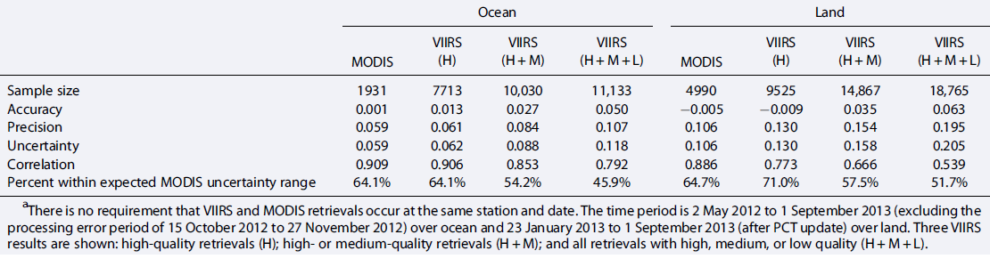
Validation
Comparisons with AERONET
Time period is 2 May 2012 to 1 September 2013 (excluding the processing error period) over ocean and 23 January 2013 to 1 September 2013 (after PCT update) over land.

Slide 33
Small bias from majority matchups
Underestimation over low NDVI scenes; overestimation over high NDVI scenes
Large uncertainty over arid land and dust dominated scenes

